Slide 1

SafeTO – Mental Health
Toronto Police Service Case Competition
Prepared by Team DIYI

Slide 2
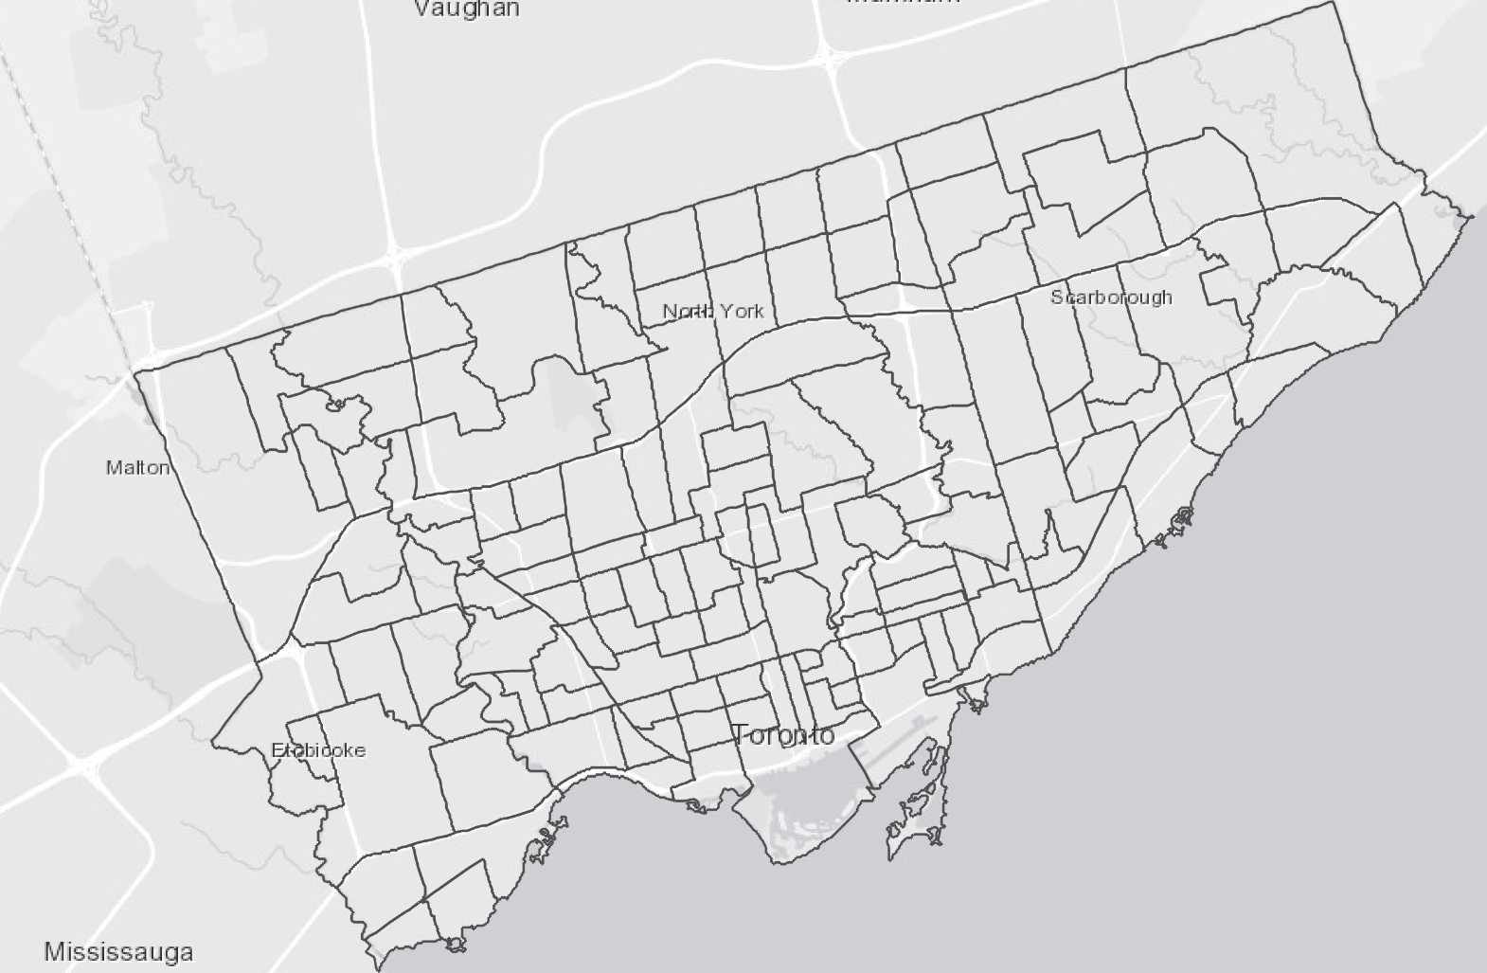
Increasing Mental Health Calls and Geographical Variation
Increasing Cases of Mental Health Calls by Year
Geographical Distribution of Mental Health Calls
MIN: Yorkdale – Glen Park
Reported Case: 227
MAX Church – Yonge Corridor
Reported Case: 2,104
2014
2015
2016
2017
2018
2019
2020
Identify risk levels regarding different neighborhoods.

Slide 3
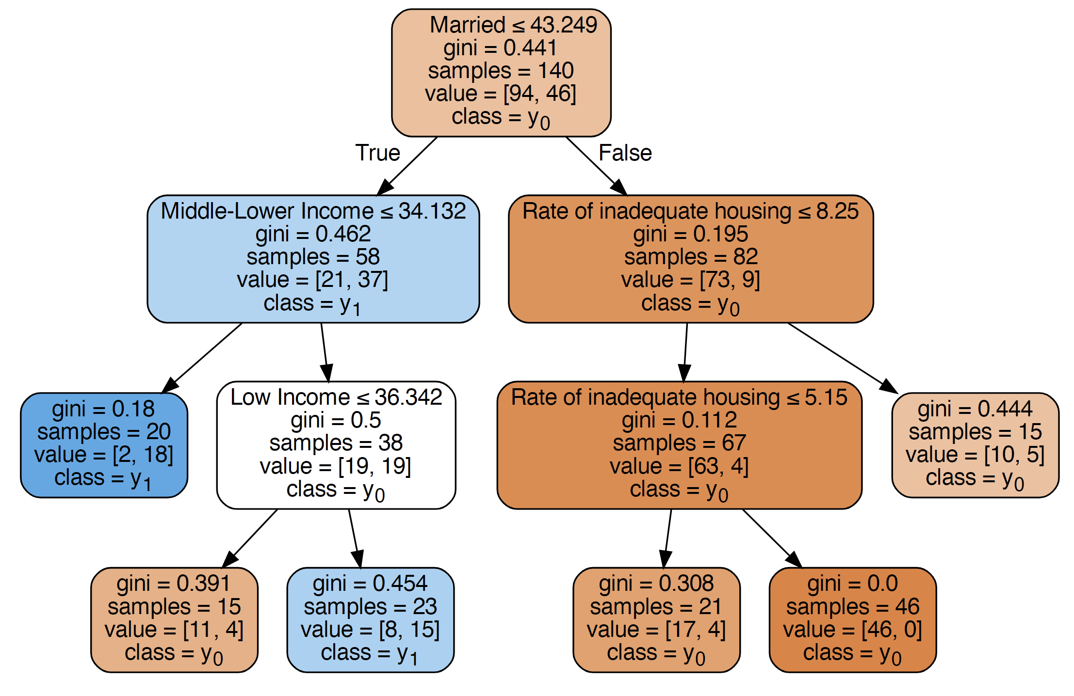
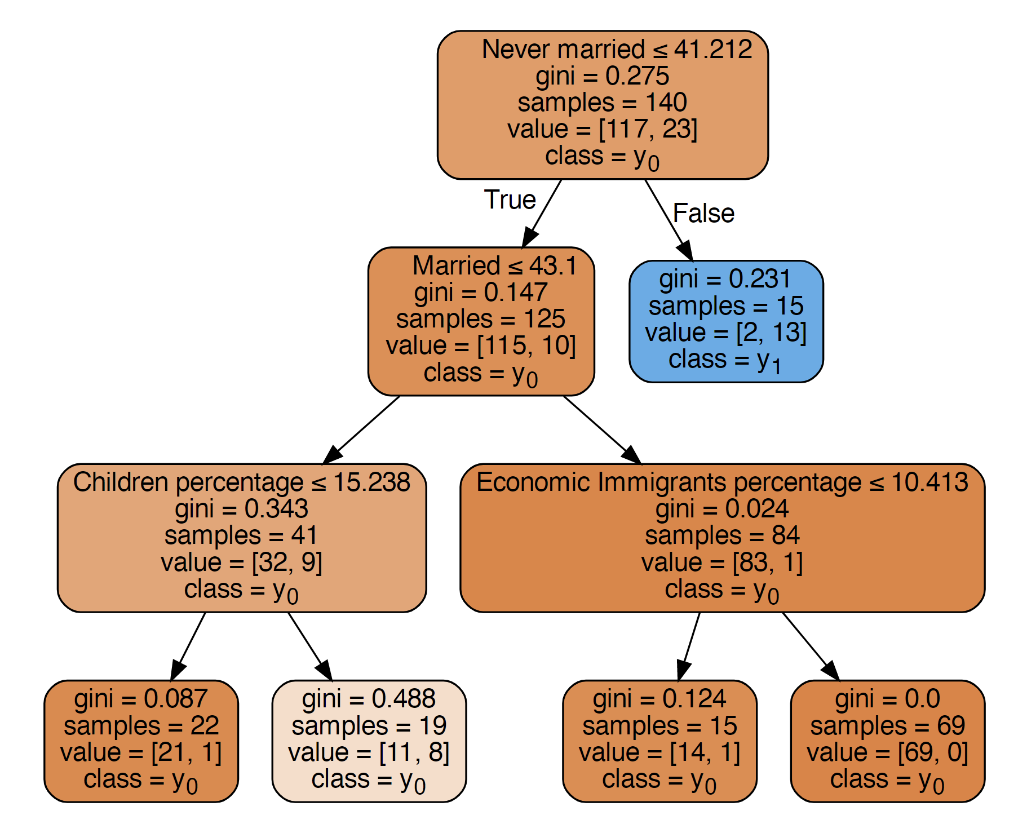
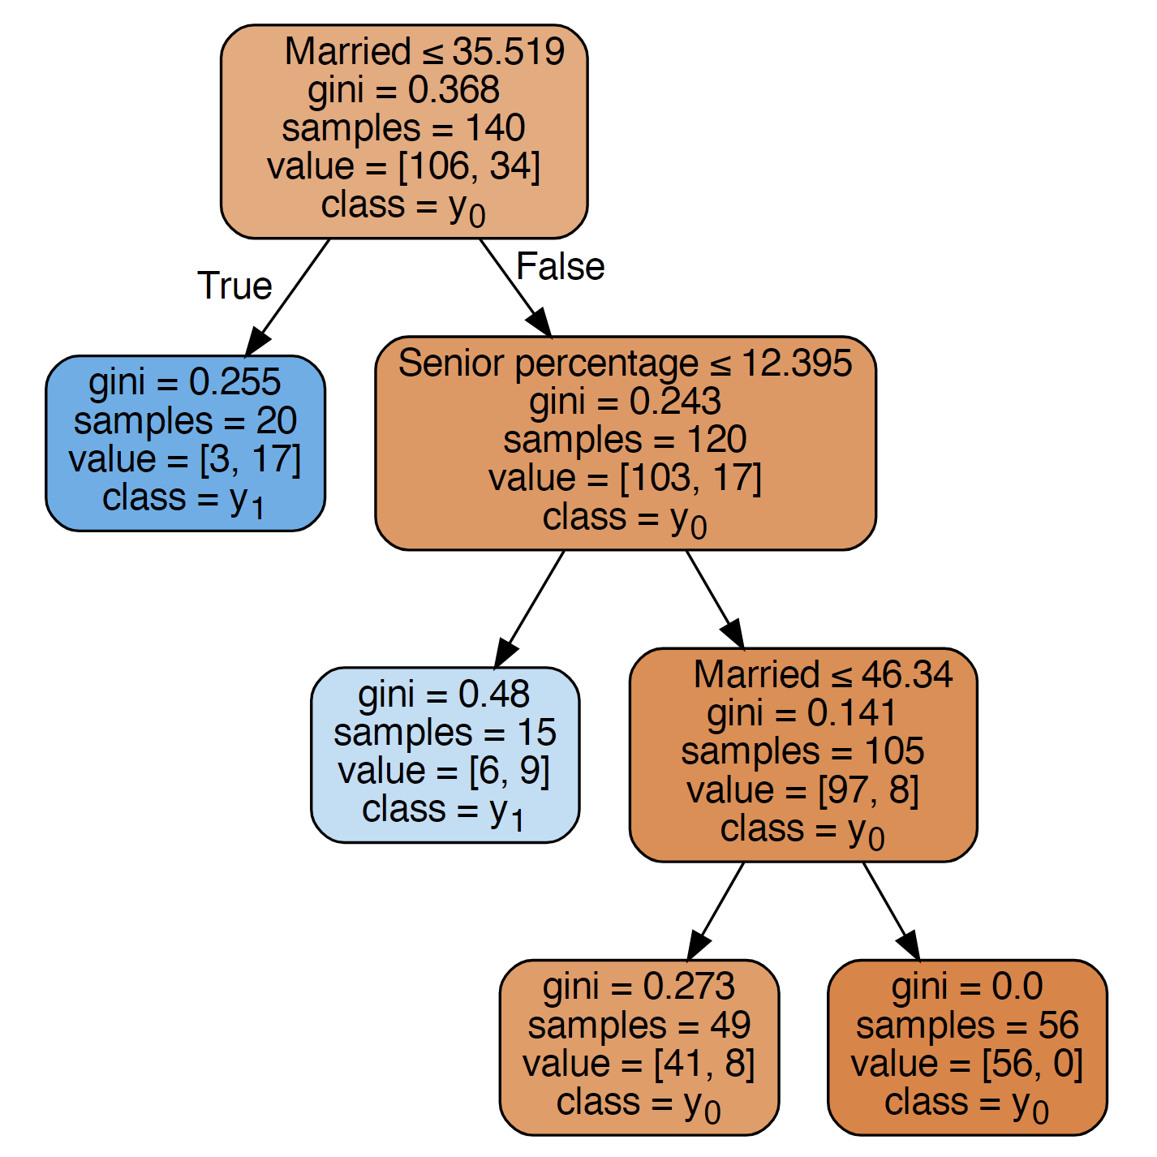
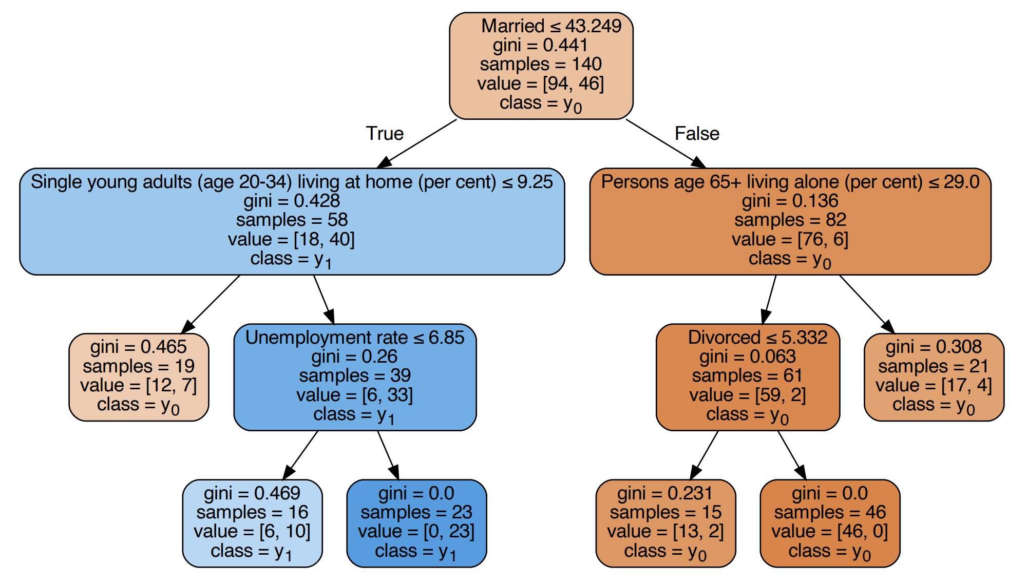
Methodology - Decision tree
Decision Tree Outputs
Explanation
What causes High Apprehension Rate?
Target: Apprehension Rate of Each Neighborhood
High
Apprehension Neighborhoods
Marriage
1.75%
Threshold: Average Apprehension Rate Among All Neighborhoods
Income
Low
Apprehension Neighborhoods
Effective Predictors
Marriage
< 43.25%
Youth% (Age)
High
Risk
Neighborhoods
Low Income
> 36.34%
Youth%
> 9.25%

Slide 4
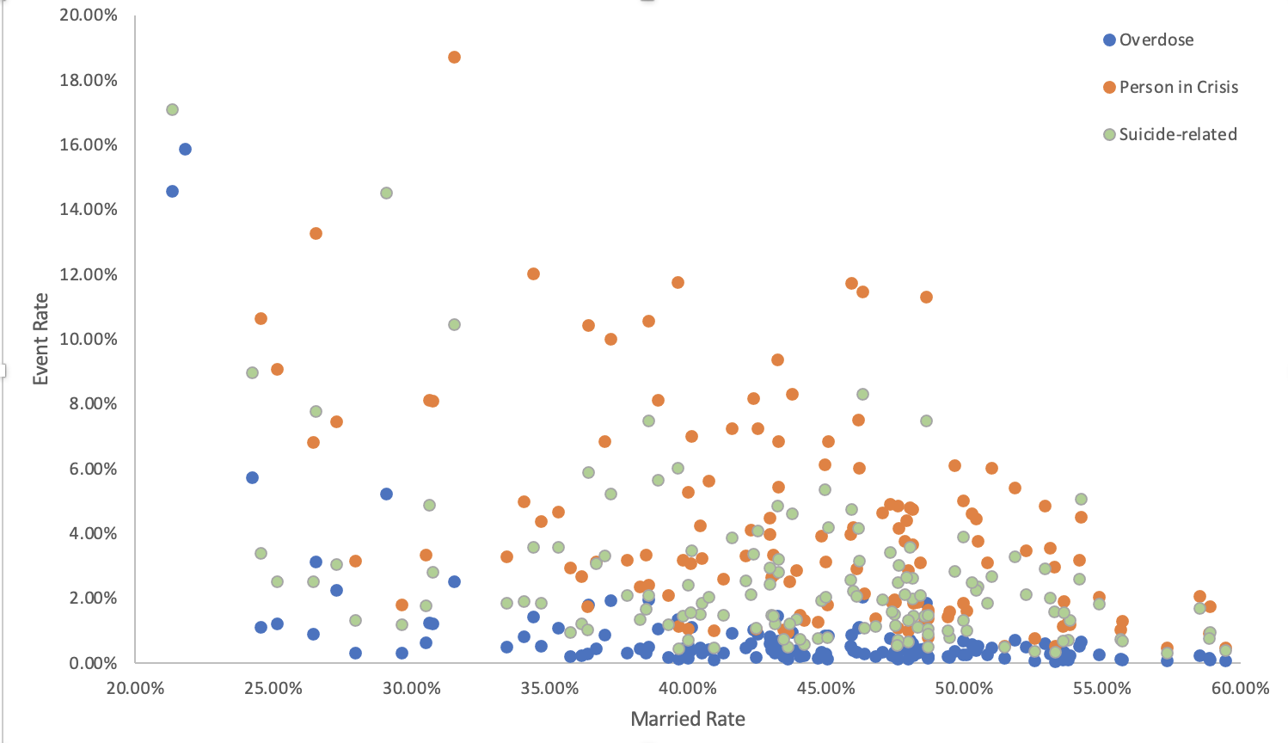

Marital Status
Marital Status
Life Stability
Financial Condition
Life Positivity
Good marital status impose positive effects on Mental Status
Neighborhoods with higher marital rate have lower mental health apprehension cases

Slide 5
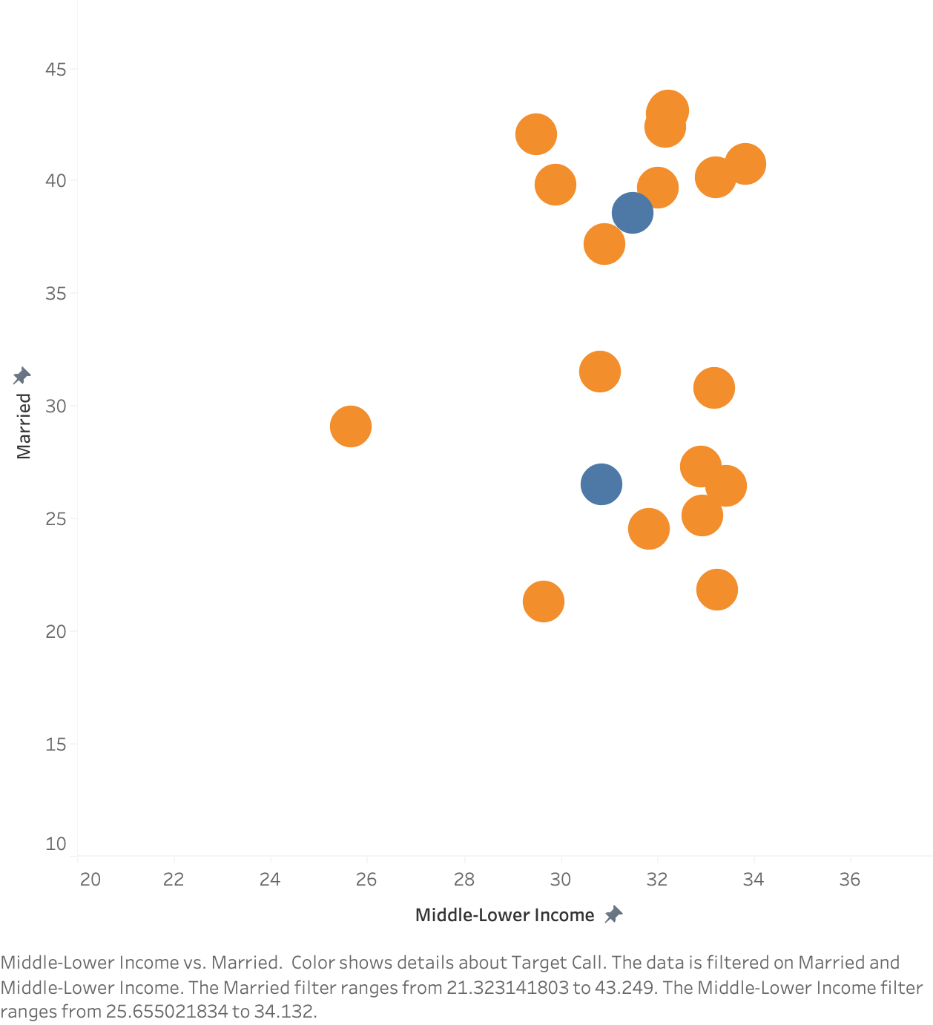
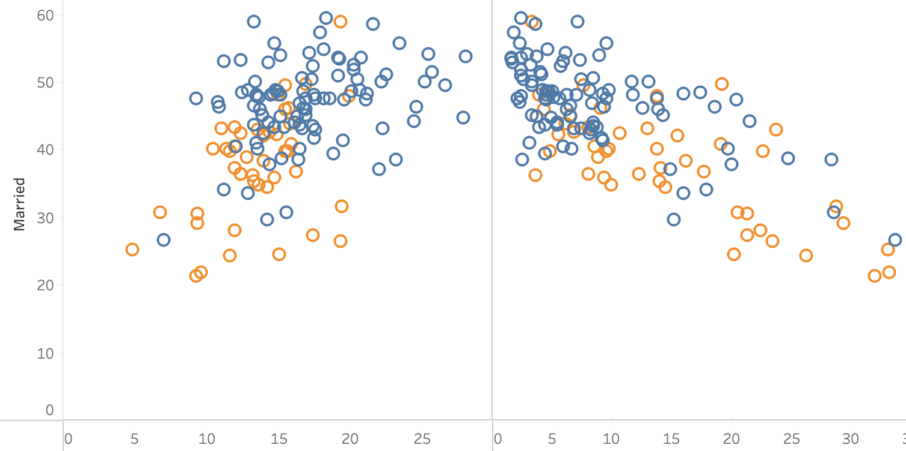













Low Income & Youth
Income
Age
Middle-Low Income %
Senior %
Youth Live Alone%
Married
Low Risk Neighborhood
Low Risk Neighborhood
High Risk Neighborhood
High Risk Neighborhood
% of Married
% Senior
Highest
Risk
Neighborhood
Please Pay More Attention
% of Middle-Low
Income
% Young Adults
Live Alone
Notes:
- When Marriage & Middle-Low Income
Additionally, we associated the comparatively large number of mental crisis related apprehensions in the low-income population with its weak tolerance to negative economic impact, so they may bear sustained high mental pressure concerning survival and could not afford or have sufficient resources in mental health assistance, which make them vulnerable to nervous breakdown and may eventually develop severe mental crisis.
Lastly, our analysis indicated that neighborhoods with more unemployed young population are more prone to have high apprehension rates for mental crisis, this result in a way corroborates our previous argument of the association between low income and the number of apprehensions made due to mental crisis. On the other hand, we suspect that the unemployment-induced anxiety and poverty could severely jeopardize individual’s mental health and they may seek amelioration through the usage of drug or alcohol, which further deteriorate their mental health condition.

Slide 6




Recommendation
Police Force Allocation
Allocate higher proportion of police force into high-risk neighborhoods with features:
Low marriage rate; High proportion of mid-low income;
Low proportion of seniors; High proportion of young adults living alone.
Mental Health
Cares
Work with local social workers to hold educational sessions about mental health with provision of free counseling services.
Employment
Improvement
Introduce workshops providing Policing knowledges or other skill trainings to prepare and reactivate unemployed young individuals back to the labor force and can also potentially recruit more suitable talents in the Police force.
Work with local government to hold and promote job fairs in these regions to reduce unemployment.
Prevention
Scrutinize illegal drug deals, alcohol purchase and consumption.
Notes:
Based on our findings, several measures could be considered to potentially forestall hazardous events and promote sustainable improvements in the safety of neighborhoods. For high risk regions that defined as having less than 40% married population, having an average income which falls in the low to middle-low range (defined previously), and having a greater than 7% unemployed population aged from 20 to 34, Toronto Police Service can:

Slide 7
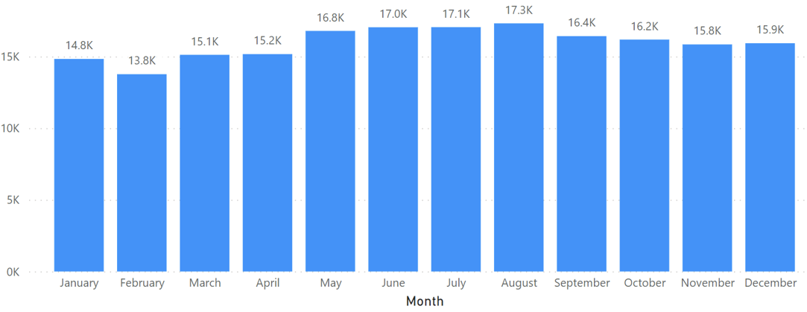
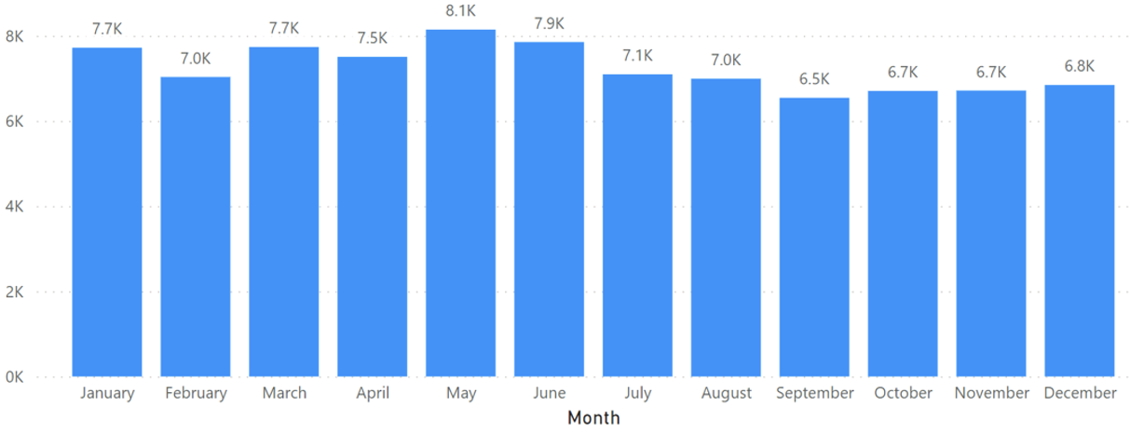
Further - Records of Apprehension VS Seasonality
Apprehension distribution within youth and all age groups shows different seasonality patterns. Further analysis regarding the effects of weather could be conducted to investigate monthly police calls and force allocation.
All Age Groups
The histogram describes the scenario when police force apprehend the subject after receiving the call reporting subject’s in-crisis status. We see during the warmer months, the apprehension rate is much higher than others.
Dataset: Persons_in_Crisis_Calls_for_Service_Attended
Youth Only
This histogram describes the apprehension cases that were due to mental crisis. Based on the plot on the right, splitting by the month of July, we see that on average, the number of apprehended cases recorded in the first half of the year is higher than the number of records in the second half of the year.
Dataset: Mental_Health_Act_Apprehensions

